Slide 1
MTA Data analysis
Yonga Lhamo

Slide 2
Agenda
Introduction
Exploration
Filter
Visualization
Solution

Slide 3
Introduction
Outline of a Problem
WomenTechWomenYes (WTWY) has their annual summer gala to raise funds for their growing organization and also to spread awareness about increasing participation of women in technology. They need help in optimizing the placement of their street teams around New York City to gather maximum amount of signatures and attendees for the gala.

Slide 4
PROBLEM
MTA Turnstile DATASET
Subway traffic information for the month of March, April and May 2019
Zip codes dataset
Google API
Neighborhood DAtaset
Millennials account for about a quarter of the $48 billion spent on other products in 2018
Turnstile coordinates
Loss of productivity costing consumers thousands of dollars

Slide 5
Exploration
Each Turnstile in the MTA has a unique identification
A single or a cluster of turnstiles can make up each station
The Audits are most done with 4 hour time intervals
Issues: lack of accuracy and consistancy

Slide 6
Exploration
Entries and Exits have counters that are continuous since inception for each turnstile
Stations with highest volume of commuters can be found by adding up the traffic for each of its turnstiles over the given timeframe

Slide 7
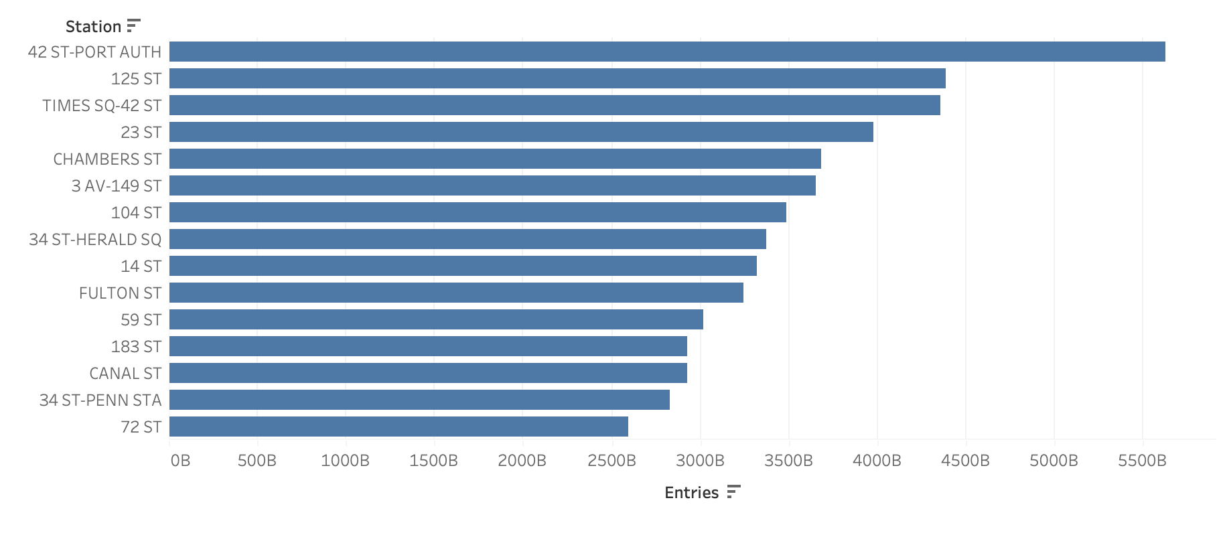

Slide 8
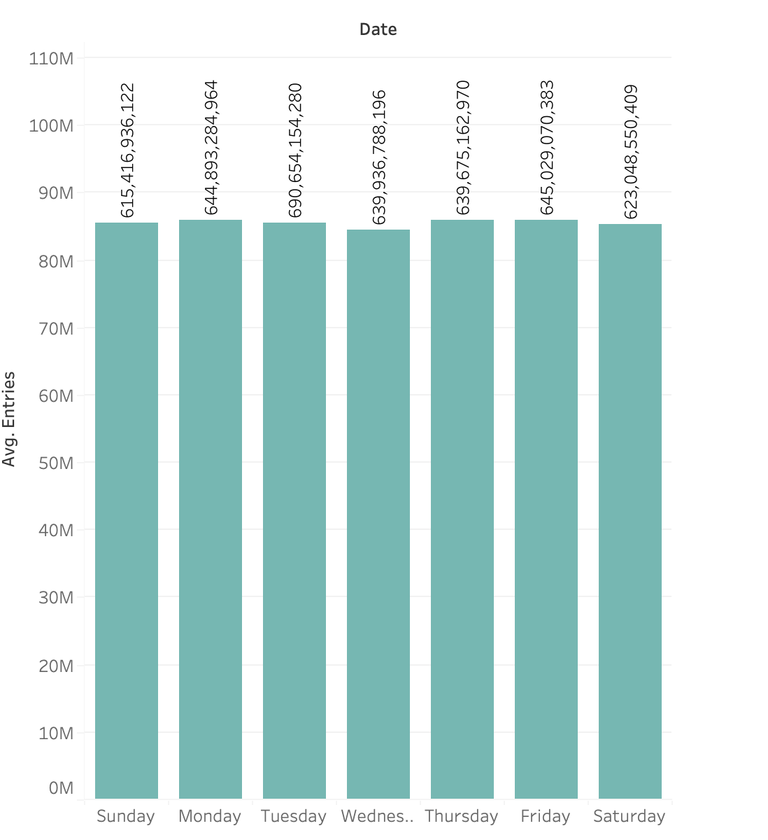
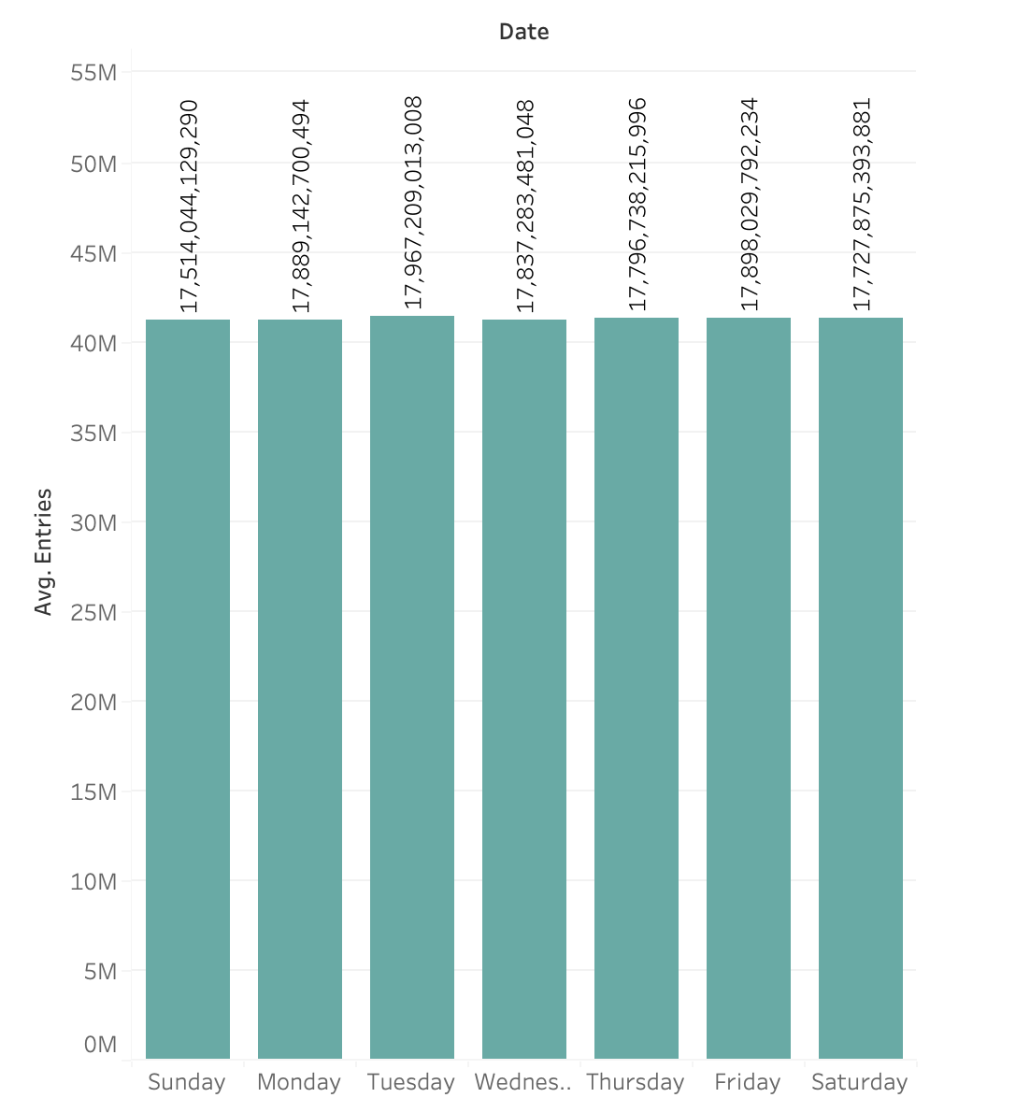
34 ST PENN STATION
Average volume: All Stations

Slide 9
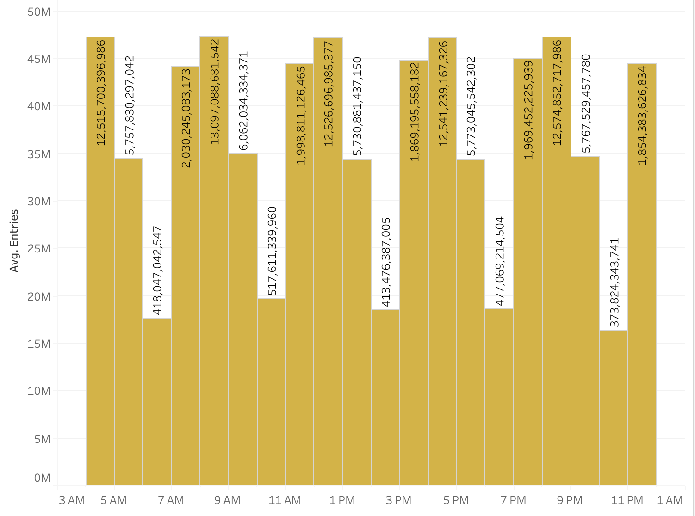

Slide 10
After some remedies
For each turnstile, take the last audit value and negate from previous
Set an upperbound and reset count to best save and estimate count
Set the negative values positive

Slide 11
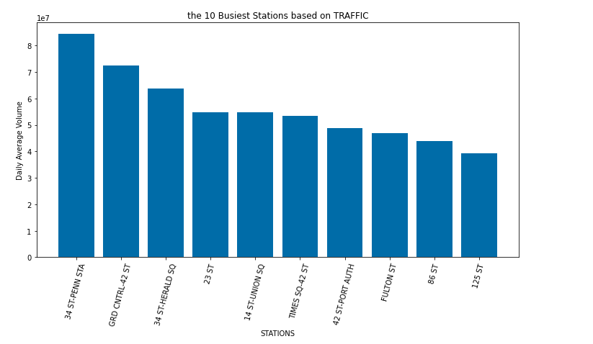

Slide 12
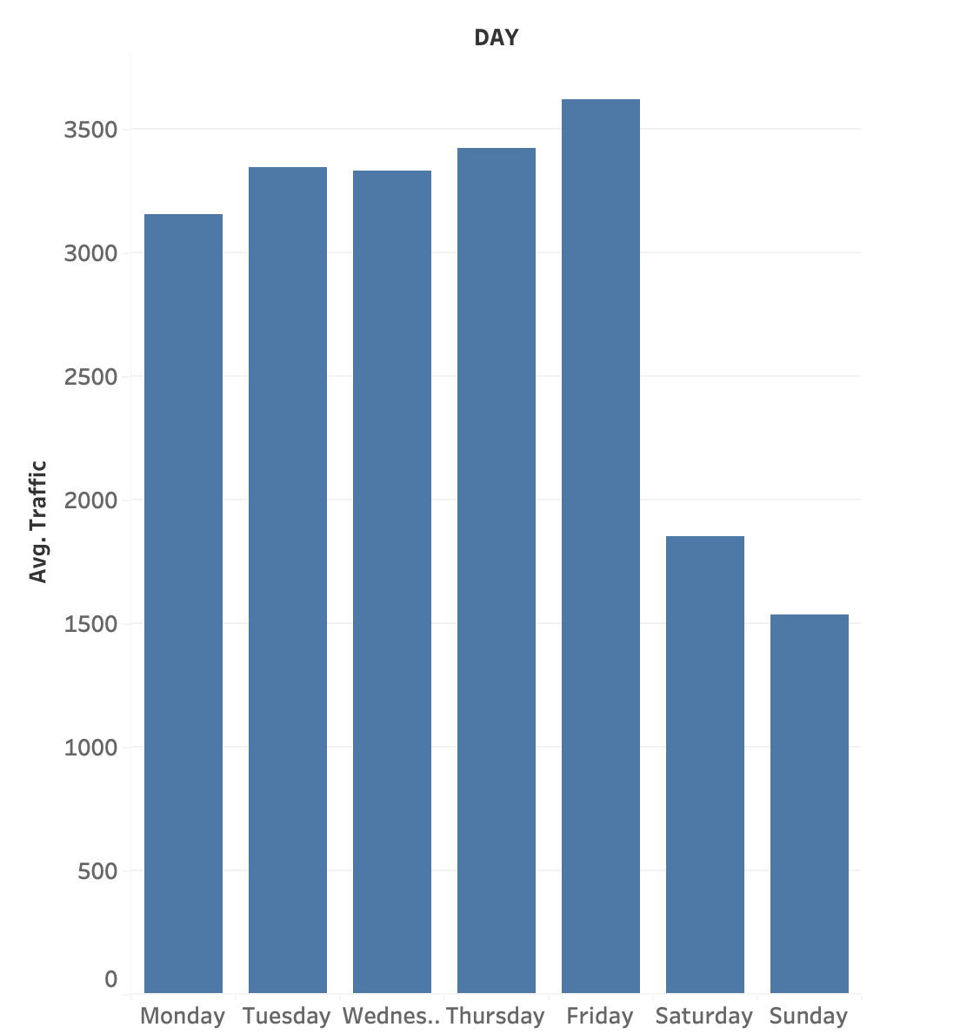
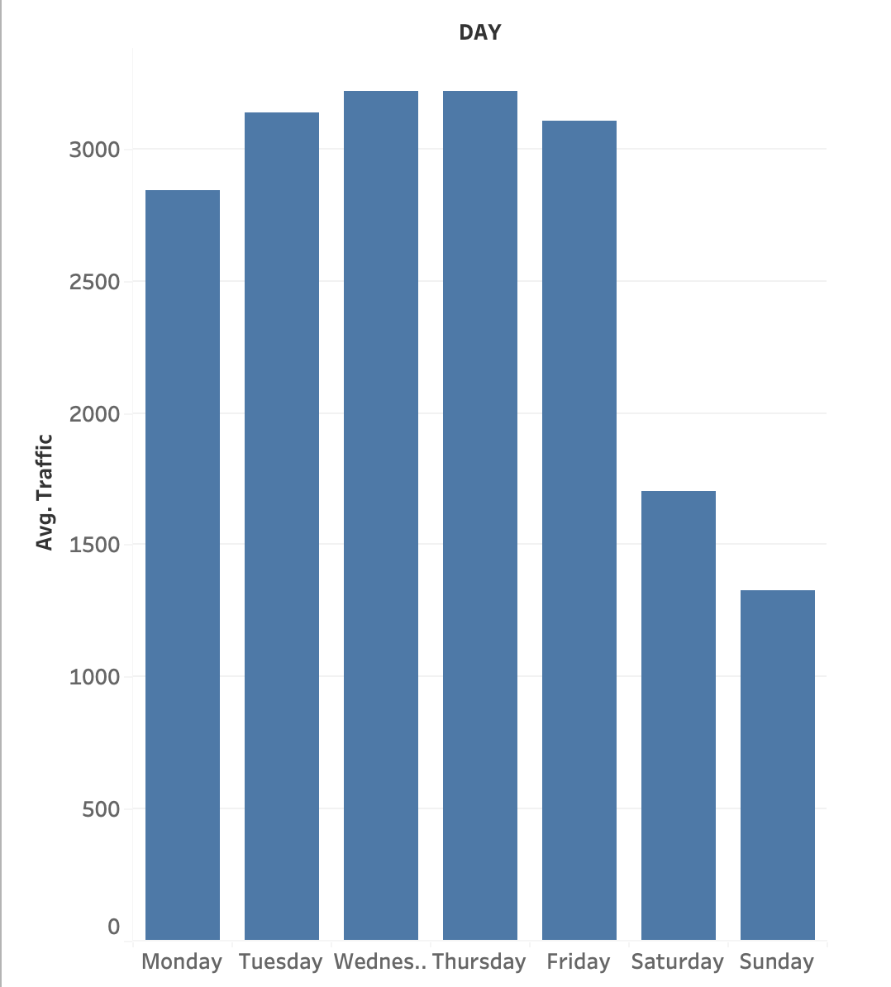
AVERAGE TRAFFIC 34-ST PENN STATION
AVERAGE TRAFFIC FOR ALL STATION

Slide 13
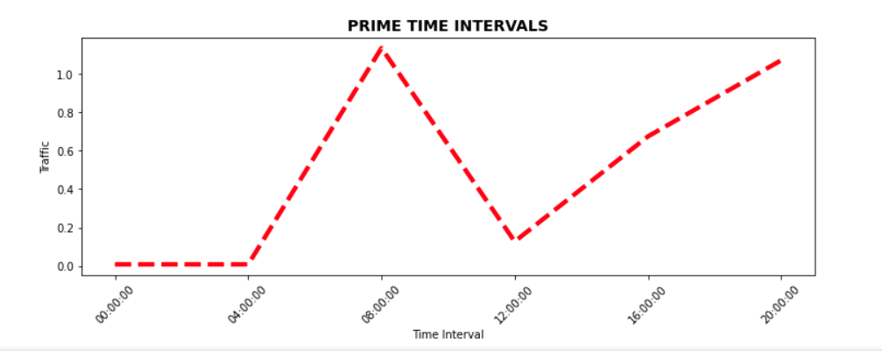
The prime time intervals are between 7 am to 9am and 4pm to 8pm

Slide 14
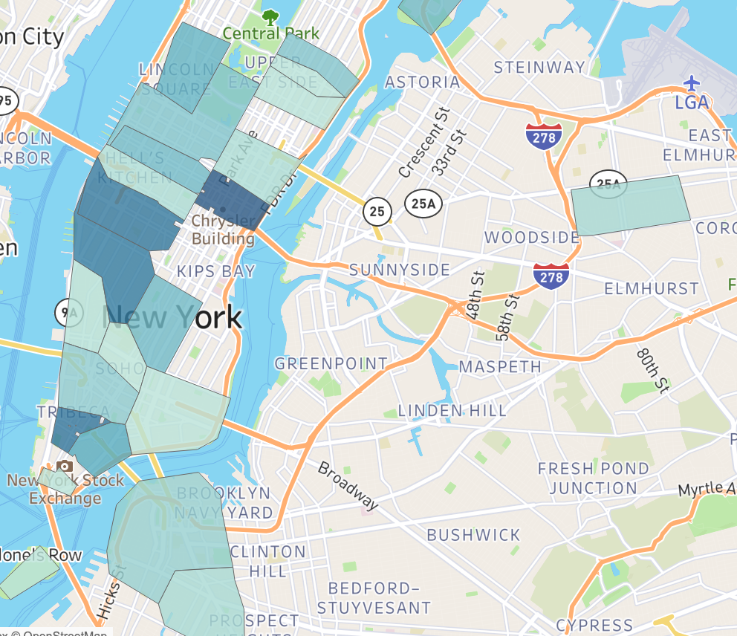
FILTER
Filter data to the top 30 stations and merge
zip code dataset. These are the some of the locations.

Slide 15
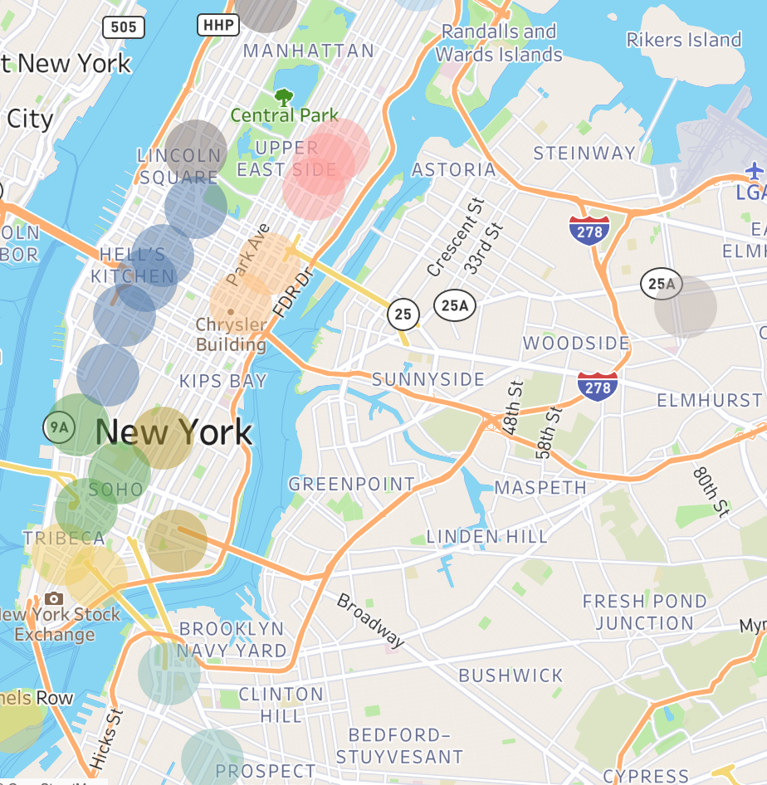
Merge with neighborhood data .
Visualized here.
Further filter the dataset by selecting five neighborhoods that pertain to the objective of the analysis.
Chelsea and Clinton
Gramercy Park and Murray Hill
Lower Manhattan
Sunset Park
Upper East side
FLORA BERGGREN​
Chief Operations Officer
GRAHAM BARNES
ROWAN MURPHY
ELIZABETH MOORE
VP Product
SEO Strategist
Product Designer

Slide 16
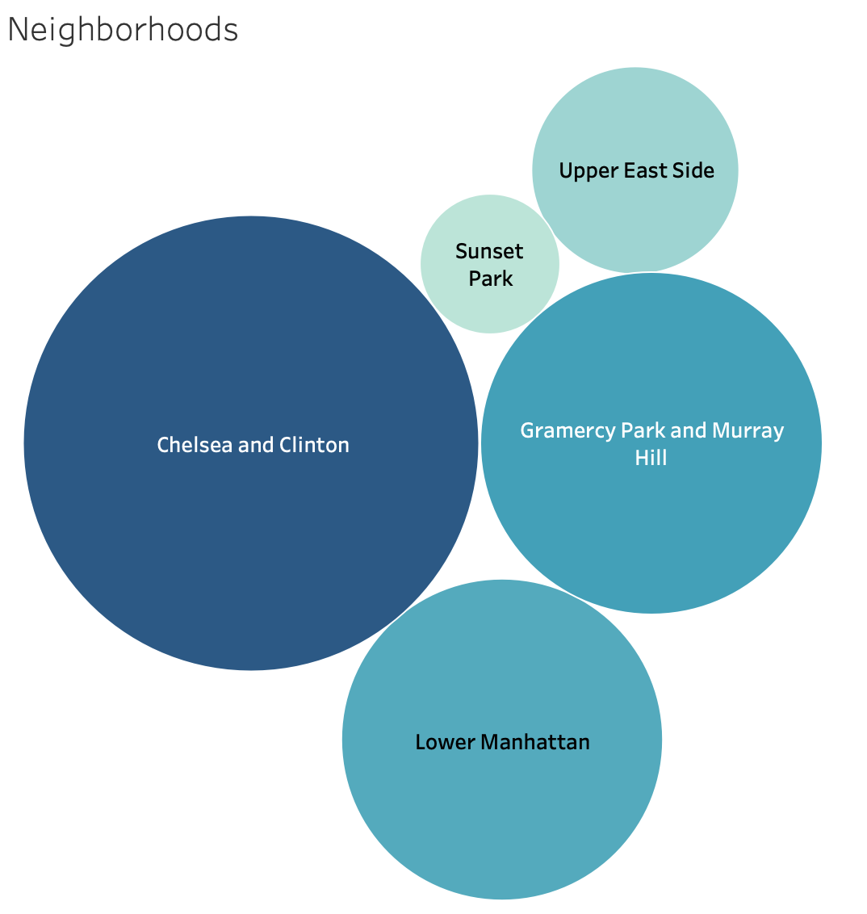
Chelsea and Clinton
High Traffic and tech hub
Gramercy Park and Murray Hill
High Traffic and tech hub
Lower Manhattan
High Traffic and tech hub
Sunset Park
Tech hub
Upper East side
Finance

Slide 17
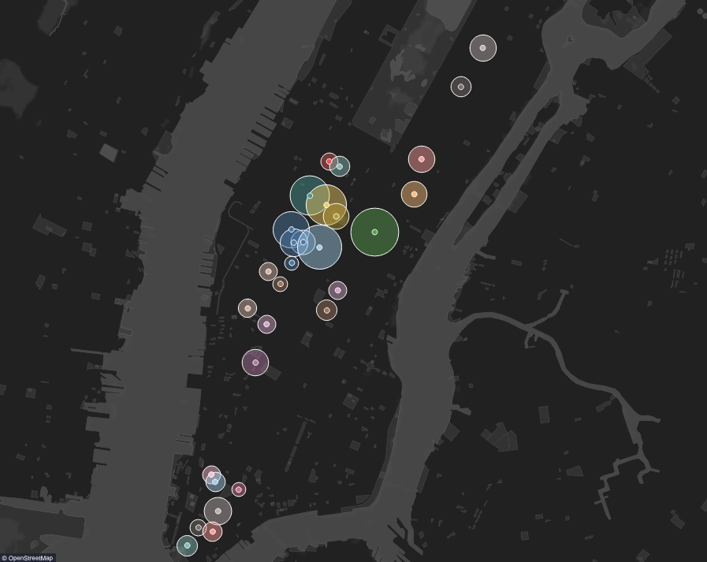
UNIQUE
Only product specifically dedicated to this niche market
FIRST TO MARKET
First beautifully designed product that's both stylish and functional
TESTED
Conducted testing with college students in the area
AUTHENTIC
Designed with the help and input of experts in the field
Merge data with Turnstile geo locations

Slide 18
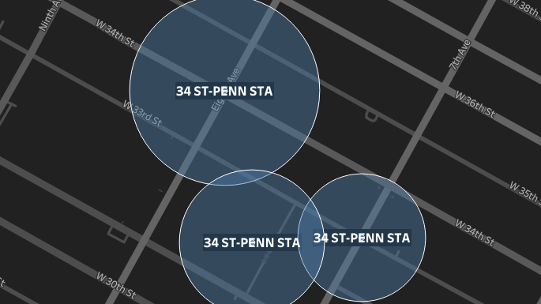

Slide 19
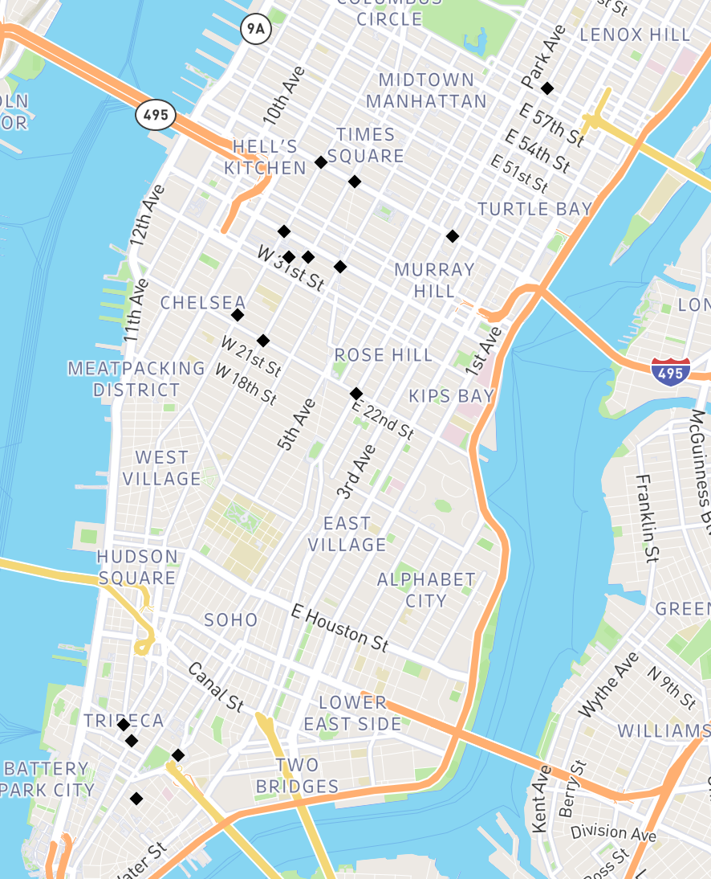
SOLUTION
Further filter by sorting turnstile on traffic.
$3B
$2B
Yours Locations!
Opportunity to build
Freedom to invent
Addressable market
Serviceable market

Slide 20
SUMMARY
DATASET
5 NEIGHBORHOODS
20 TURNSTILE GEOOCATIONS
30 TOP STATIONS

Slide 21
FURTHER
Bigger sample data
donation history data based on neighborhoods
Education dataset
Data relating to interest in social causes

Slide 22
THANK YOU!

